Slide 1

FOOTBALL DATA ANALYTICS

Slide 2



AGENDA
DATA ANALYSIS ON FIFA DATA USING PYSPARK
2) PREMIER LEAGUE DATA ANALYSIS USING PYTHON

Slide 3
APACHE SPARK
Apache Spark is a multi-language engine for executing data engineering, data science, and machine learning on single-node machines or clusters.
It provides high-level APIs in Scala, Java, Python, and R, and an optimized engine that supports general computation graphs for data analysis.

Slide 4
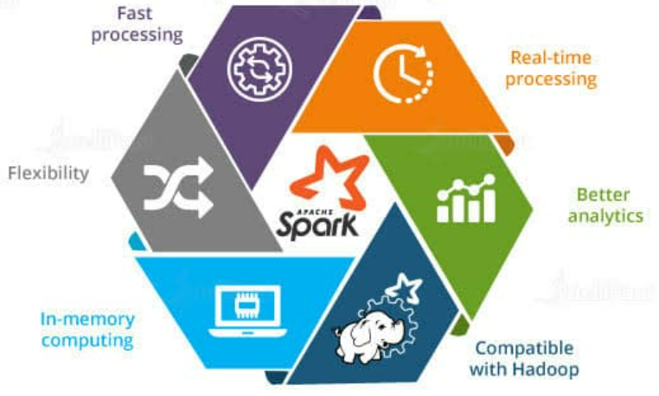
KEY FEATURES OF APACHE SPARK

Slide 5
KEY FEATURES OF APACHE SPARK
FAST PROCESSING
Big data is characterized by its volume, variety, velocity, value, and veracity due to which it needs to be processed at a higher speed. Spark contains Resilient Distributed Datasets (RDDs) that save the time taken in reading and writing operations, and hence it runs almost 10–100 times faster than Hadoop.
FLEXIBILITY
Apache Spark supports multiple languages and allows developers to write applications in Java, Scala, R, or Python. Equipped with over 80 high-level operators, this tool is quite rich from this aspect.
IN-MEMORY COMPUTING
Spark stores data in the RAM of servers, which allows it to access data quickly, and in-turn this accelerates the speed of analytics.

Slide 6
KEY FEATURES OF APACHE SPARK
REAL-TIME PROCESSING
Spark is able to process real-time streaming data. Unlike MapReduce, which processes the stored data, Spark is able to process the real-time data and hence is able to produce instant outcomes.
BETTER ANALYTICS
Contrasting to MapReduce that includes Map and Reduce functions, Spark has much more in store. Apache Spark comprises a rich set of SQL queries, Machine Learning algorithms, complex analytics, etc. With all these Spark functionalities, Big Data Analytics can be performed in a better fashion.
COMPATIBLE WITH HADOOP
Spark is not only able to work independently; it can work on top of Hadoop as well. Not just this, it is certainly compatible with both versions of the Hadoop ecosystem

Slide 7
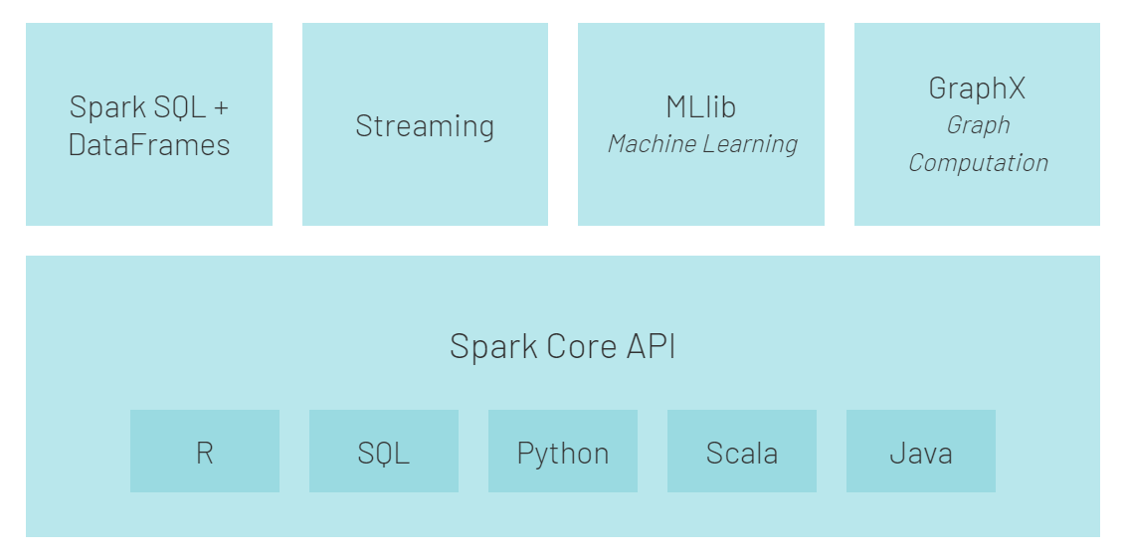
APACHE SPARK ECOSYSTEM

Slide 8
Spark SQL + DataFrames
Many data scientists, analysts, and general business intelligence users rely on interactive SQL queries for exploring data.
Spark SQL is a Spark module for structured data processing.
It provides a programming abstraction called DataFrames and can also act as distributed SQL query engine.
It enables unmodified Hadoop Hive queries to run up to 100x faster on existing deployments and data.It also provides powerful integration with the rest of the Spark ecosystem (e.g., integrating SQL query processing with machine learning).

Slide 9
MLlib
Machine learning has quickly emerged as a critical piece in mining Big Data for actionable insights.
Built on top of Spark, MLlib is a scalable machine learning library that delivers both high-quality algorithms (e.g., multiple iterations to increase accuracy) and blazing speed (up to 100x faster than MapReduce).
The library is usable in Java, Scala, and Python as part of Spark applications, so that you can include it in complete workflows.
GraphX
GraphX is a graph computation engine built on top of Spark that enables users to interactively build, transform and reason about graph structured data at scale. It comes complete with a library of common algorithms.

Slide 10
Spark Core
Spark Core is the underlying general execution engine for the Spark platform that all other functionality is built on top of.
It provides in-memory computing capabilities to deliver speed, a generalized execution model to support a wide variety of applications, and Java, Scala, and Python APIs for ease of development.
Spark Streaming
Many applications need the ability to process and analyze not only batch data, but also streams of new data in real-time. Running on top of Spark, Spark Streaming enables powerful interactive and analytical applications across both streaming and historical data, while inheriting Spark’s ease of use and fault tolerance characteristics. It readily integrates with a wide variety of popular data sources, including HDFS, Flume, Kafka, and Twitter.

Slide 11

PYSPARK
Apache Spark is written in Scala programming language.
PySpark has been released in order to support the collaboration of Apache Spark and Python, it actually is a Python API for Spark.
In addition, PySpark, helps you interface with Resilient Distributed Datasets (RDDs) in Apache Spark and Python programming language.
This has been achieved by taking advantage of the Py4j library.
Py4J is a popular library which is integrated within PySpark and allows python to dynamically interface with JVM objects.
PySpark features quite a few libraries for writing efficient programs.

Slide 12
Advantages of using PySpark:
• Python is very easy to learn and implement.
• It provides simple and comprehensive API.
• With Python, the readability of code, maintenance, and familiarity is far better.
• It features various options for data visualization, which is difficult using Scala or Java.

Slide 13
PySparkSQL
A PySpark library to apply SQL-like analysis on a huge amount of structured or semi-structured data.
We can also use SQL queries with PySparkSQL.
It can also be connected to Apache Hive. HiveQL can be also be applied. PySparkSQL is a wrapper over the PySpark core.
PySparkSQL introduced the DataFrame, a tabular representation of structured data that is similar to that of a table from a relational database management system.
GraphFrames
The GraphFrames is a purpose graph processing library that provides a set of APIs for performing graph analysis efficiently, using the PySpark core and PySparkSQL.
It is optimized for fast distributed computing.

Slide 14
MLlib
MLlib is a wrapper over the PySpark and it is Spark’s machine learning (ML) library.
This library uses the data parallelism technique to store and work with data. The machine-learning API provided by the MLlib library is quite easy to use.
MLlib supports many machine-learning algorithms for classification, regression, clustering, collaborative filtering, dimensionality reduction, and underlying optimization primitives.

Slide 15
MLlib exposes three core machine learning functionalities with PySpark:
Data Preparation: It provides various features like extraction, transformation, selection, hashing etc.
Machine Learning Algorithms: It avails some popular and advanced regression, classification, and clustering algorithms for machine learning.
Utilities: It has statistical methods such as chi-square testing, descriptive statistics, linear algebra and model evaluation methods.

Slide 16
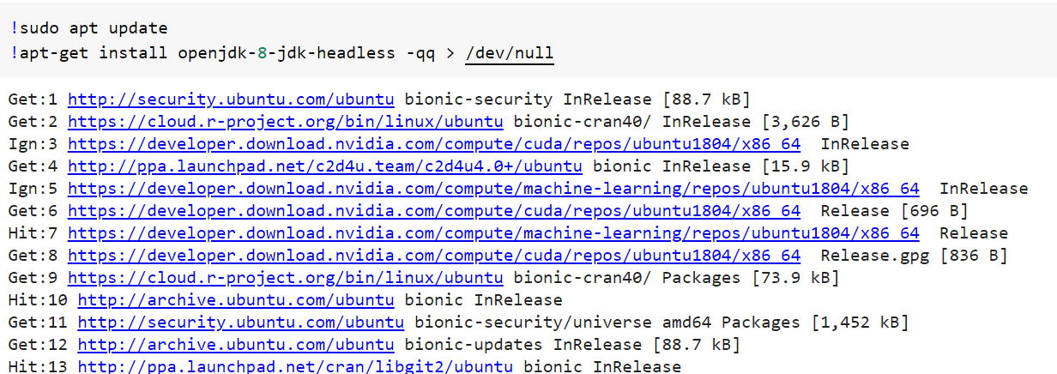
Setting Up Pyspark in Colab
Step 1: Install Java

Slide 17
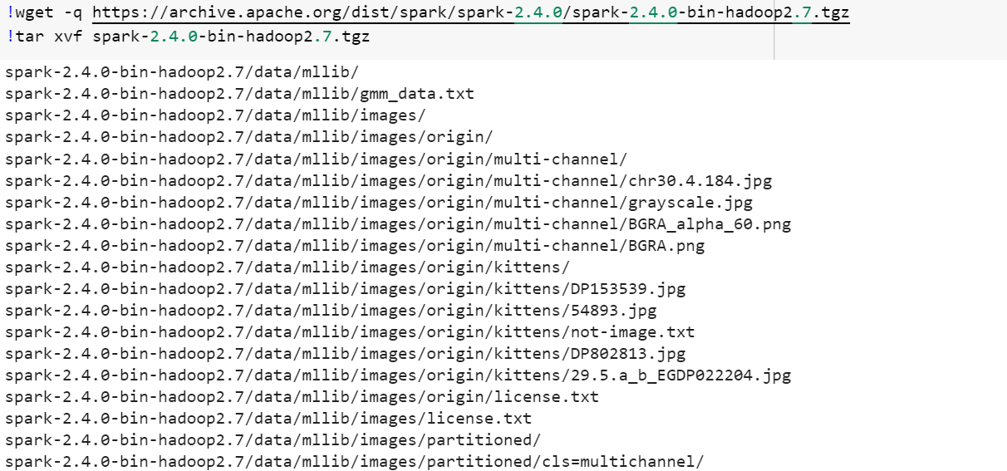
Step 2: Install Apache Spark with Hadoop

Slide 18
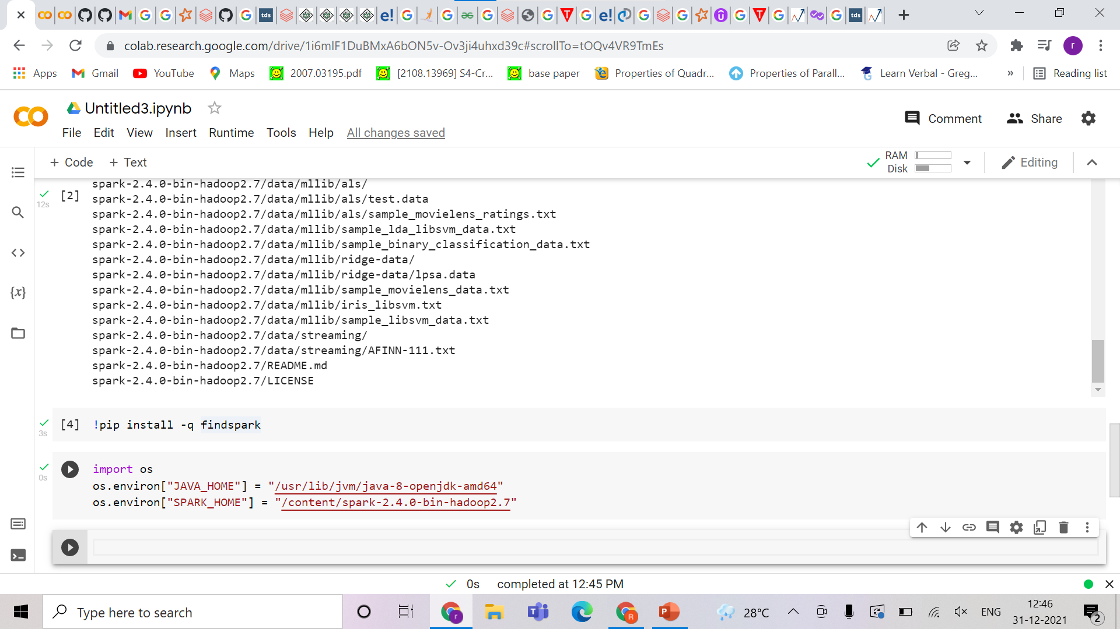
Step 3: Install findspark library which will locate Spark on the system and import it as a regular library
Step 4: Set environment variables

Slide 19
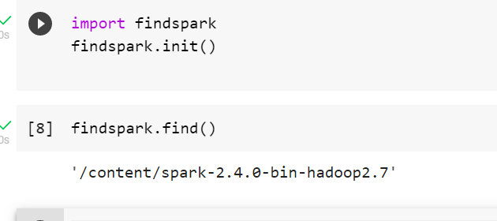
Step 5: Locate Spark in the system
Import findspark and use findspark.init( ) method
Use findspark.find() method to view location where Spark is installed

Slide 20
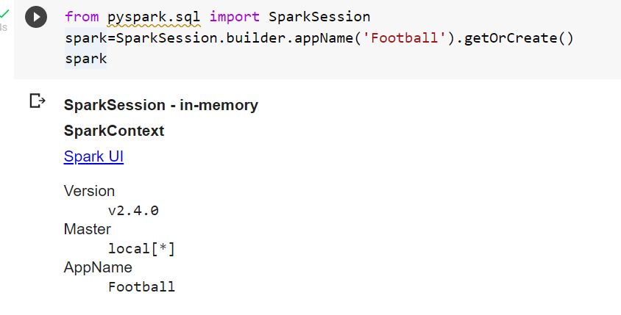
Step 6: Import SparkSession from pyspark.sql
and create a SparkSession, which is the entry point to Spark

Slide 21
DATASET
The dataset has the following properties:
Every player featuring in FIFA 19
70+ attributes
Player and Flag Images
Playing Position Data
Attributes based on actual data of the latest EA's FIFA 19 game
Attributes include on all player style statistics like Dribbling, Aggression, GK Skills etc.
Player personal data like Nationality, Photo, Club, Age, Wage, Salary etc.

Slide 22
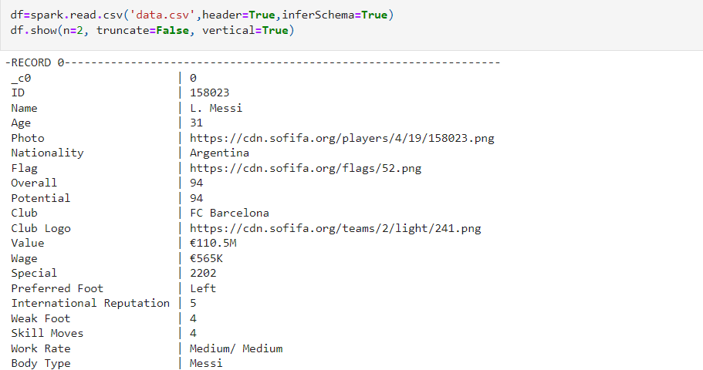
RAW DATA

Slide 23
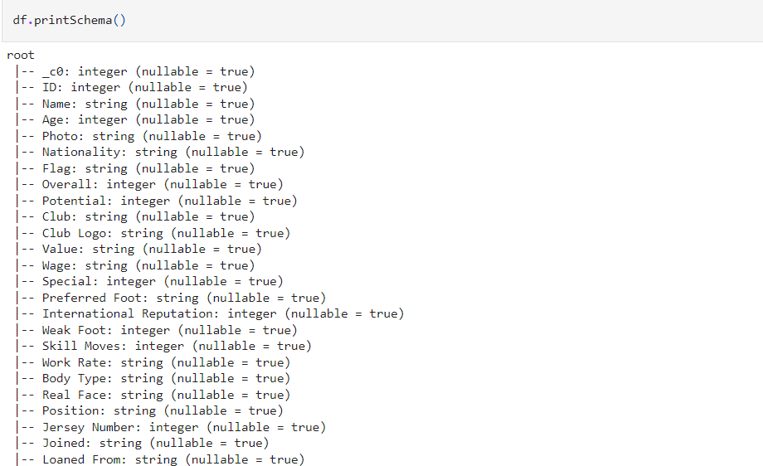
PRINT SCHEMA

Slide 24
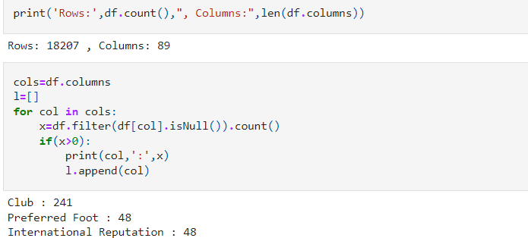
DATASET DIMENSIONS

Slide 25
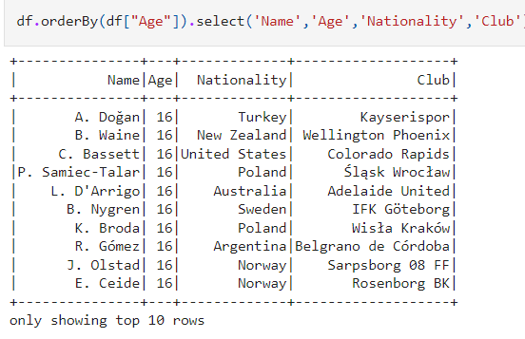
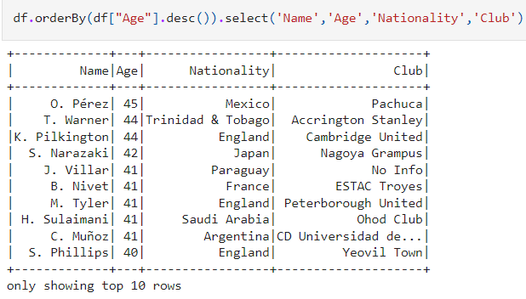
YOUNGEST PLAYERS OLDEST PLAYERS

Slide 26
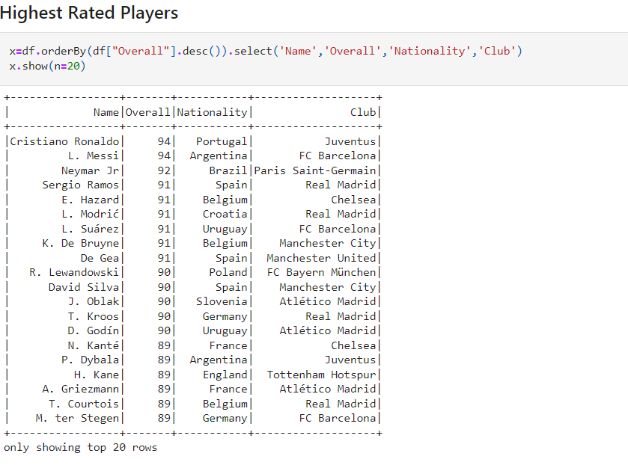
HIGHEST RATED PLAYER

Slide 27
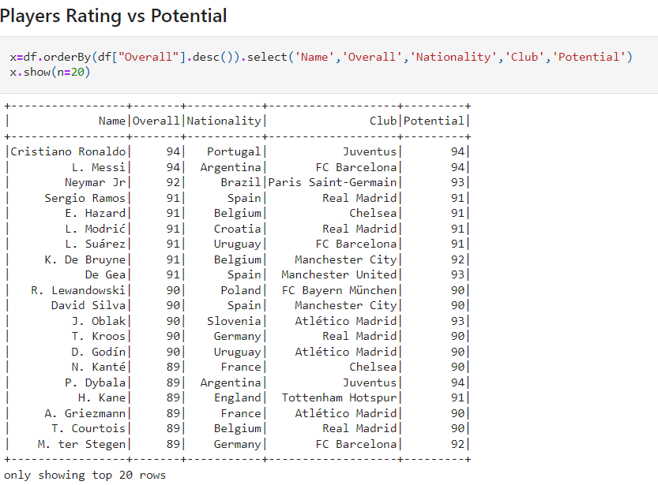
PLAYER RATING VS POTENTIAL

Slide 28
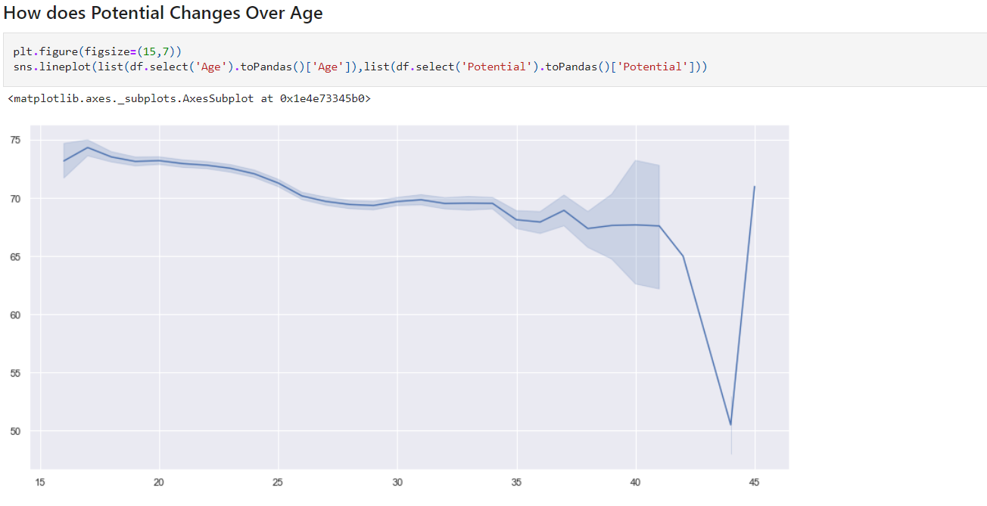
Graph showing how potential changes over age

Slide 29
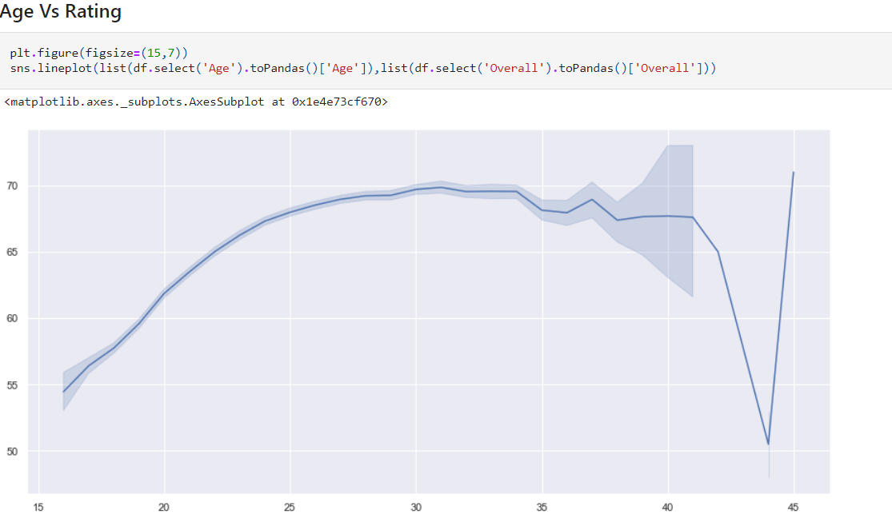
AGE VS RATING

Slide 30
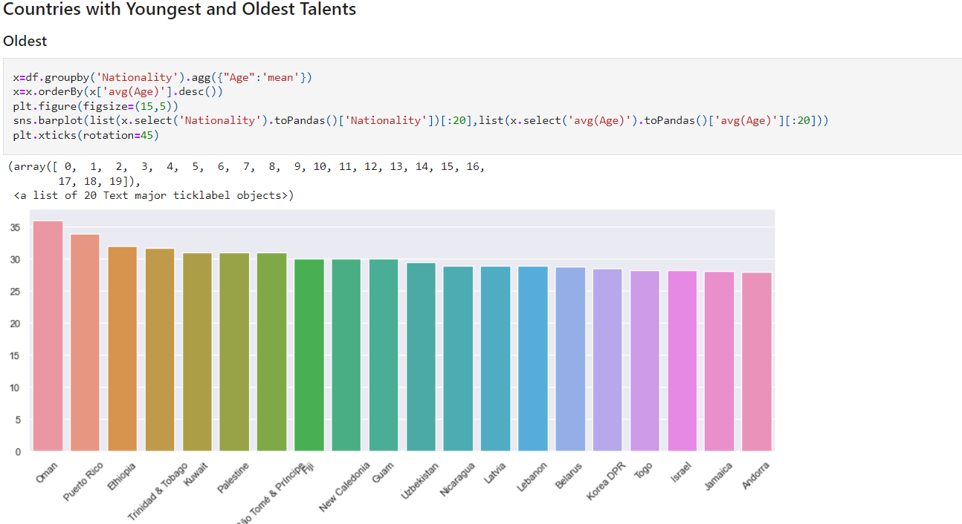
Countries with oldest talents

Slide 31
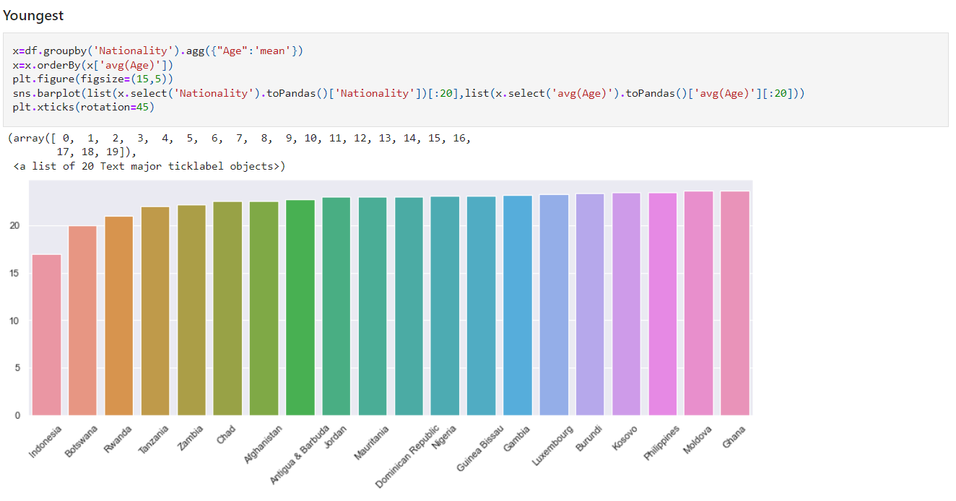
Countries with youngest talents

Slide 32
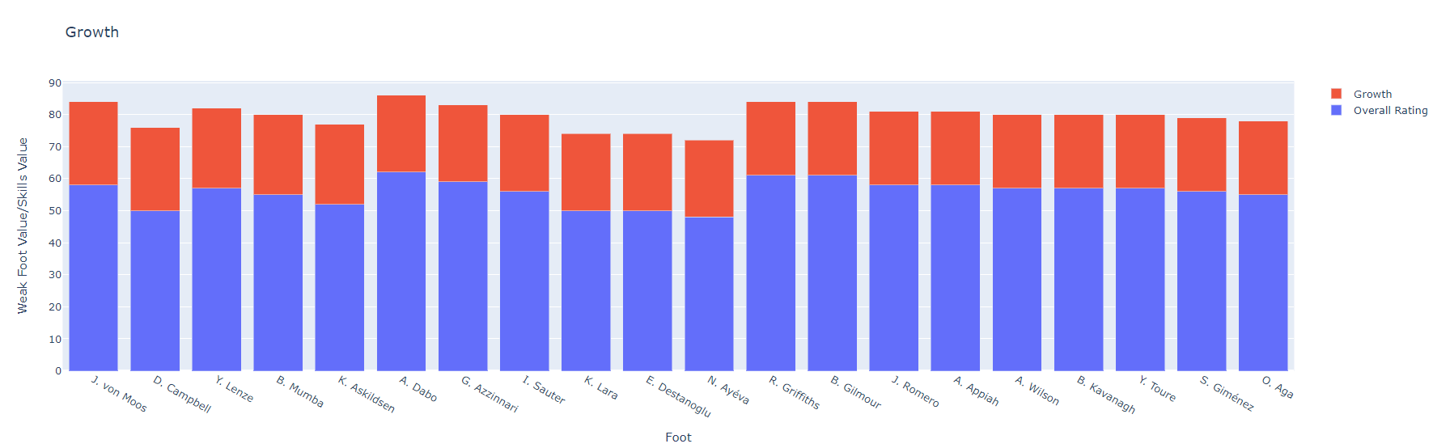
GROWTH POTENTIAL

Slide 33
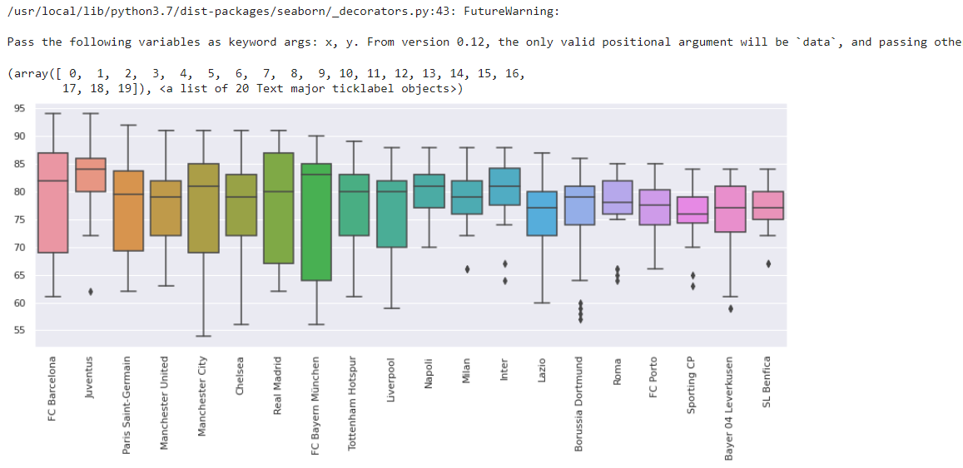
CLUB WITH BEST PLAYERS

Slide 34
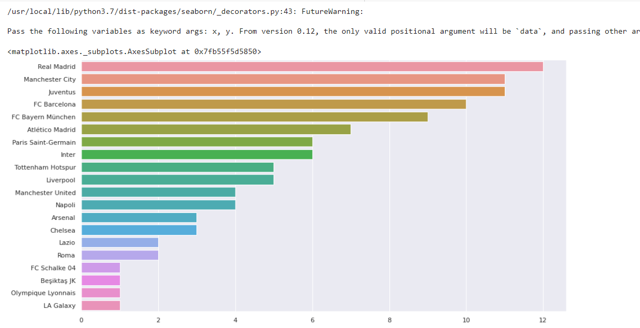
CLUB WITH MOST WORLD CLASS PLAYERS (ABOVE 85 RATING)

Slide 35
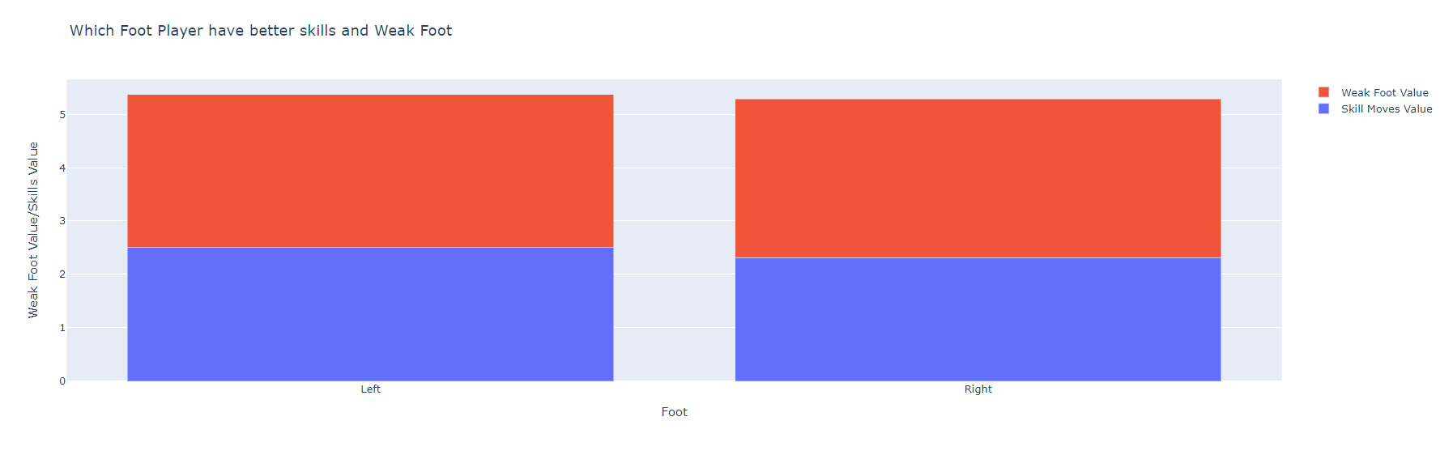
MOST PREFERRED FOOT
This comparison shows that left footed players have a slight advantage over the right footed players in terms of skills

Slide 36
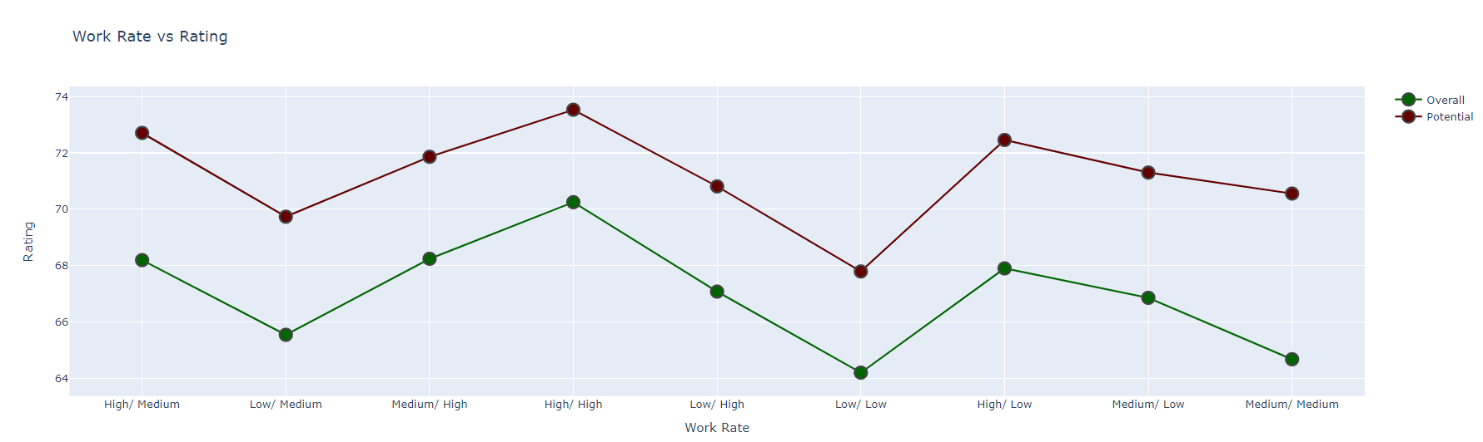
WORK RATE VS RATING

Slide 37
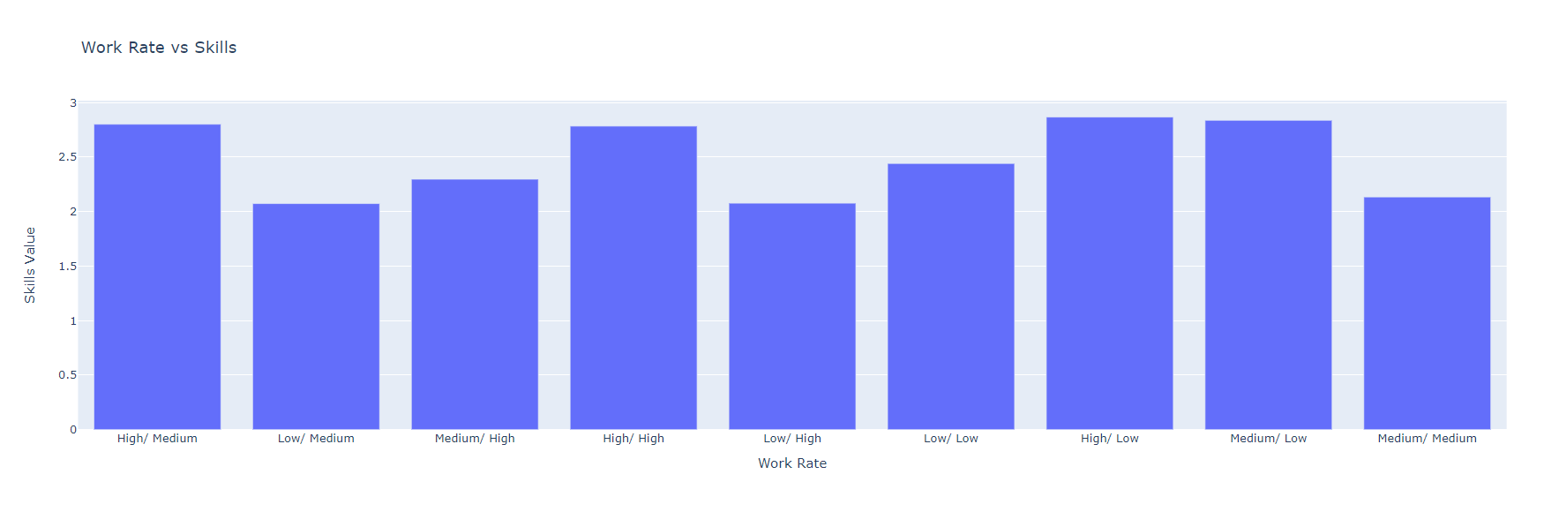
WORK RATE VS SKILLS

Slide 38
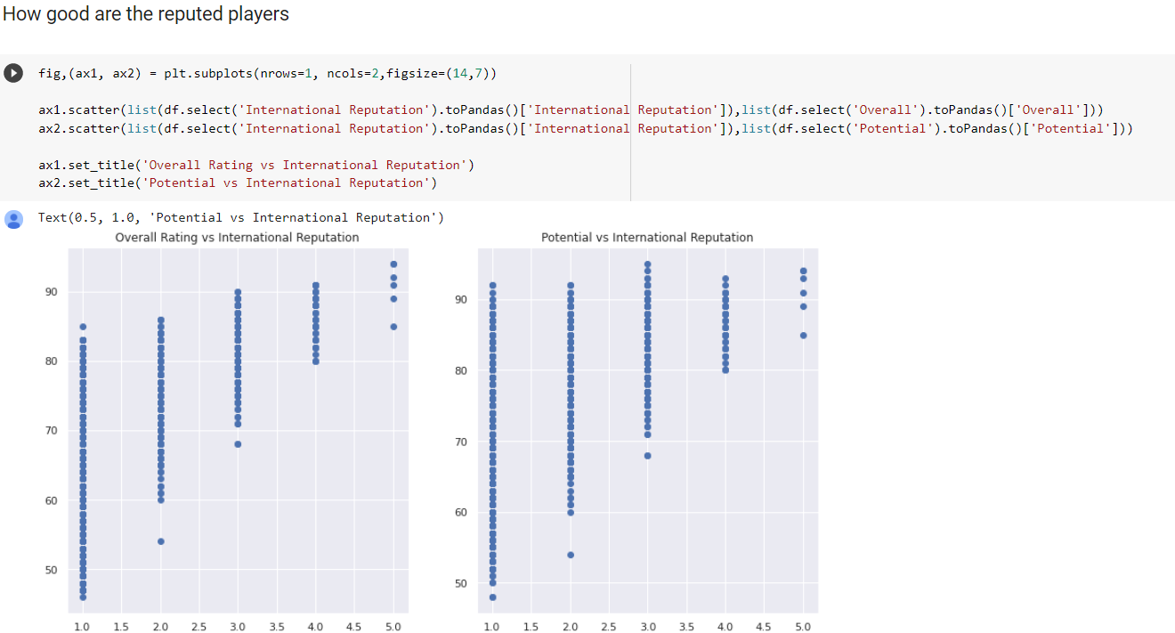
How good are reputed players?

Slide 39
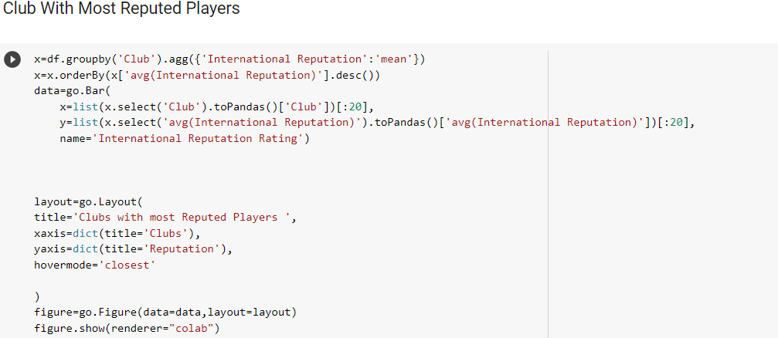
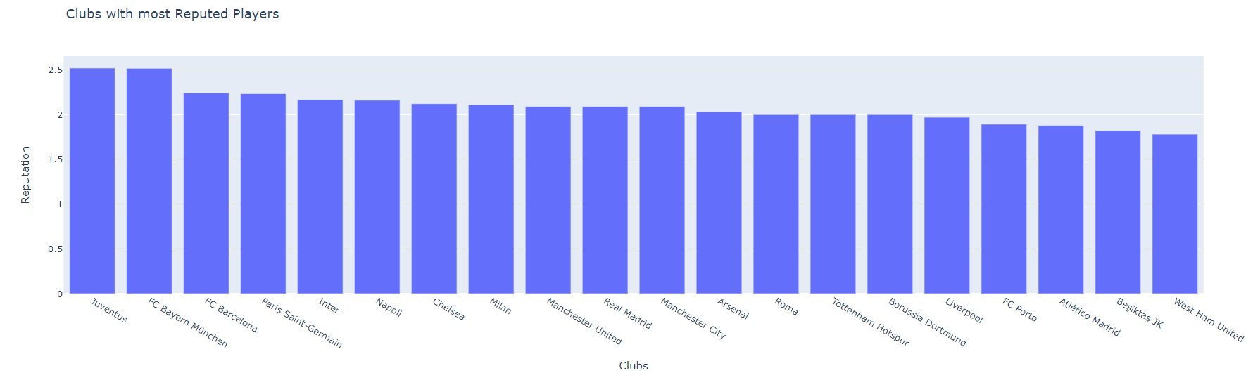
CLUBS WITH MOST REPUTED PLAYERS

Slide 40
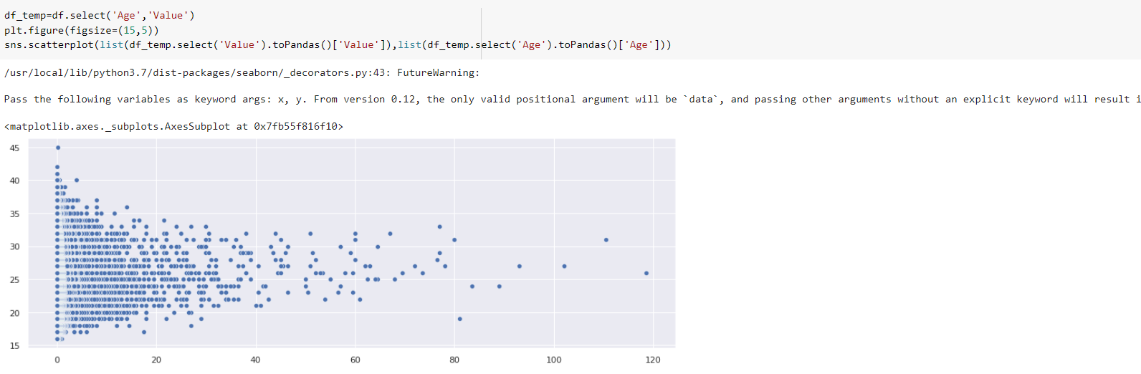
Age vs value

Slide 41
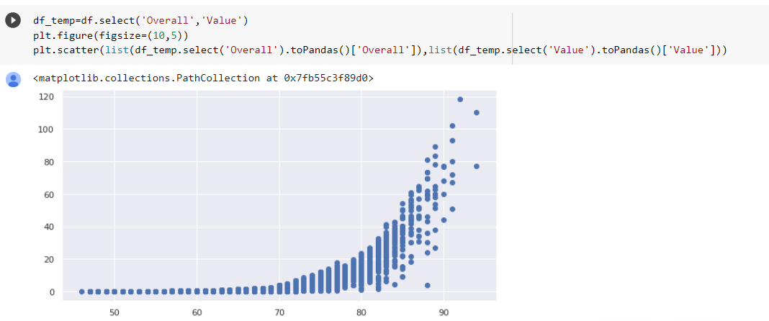
PLAYER RATING VS VALUE

Slide 42

Distribution Of Player on basis on body type and their rating

Slide 43
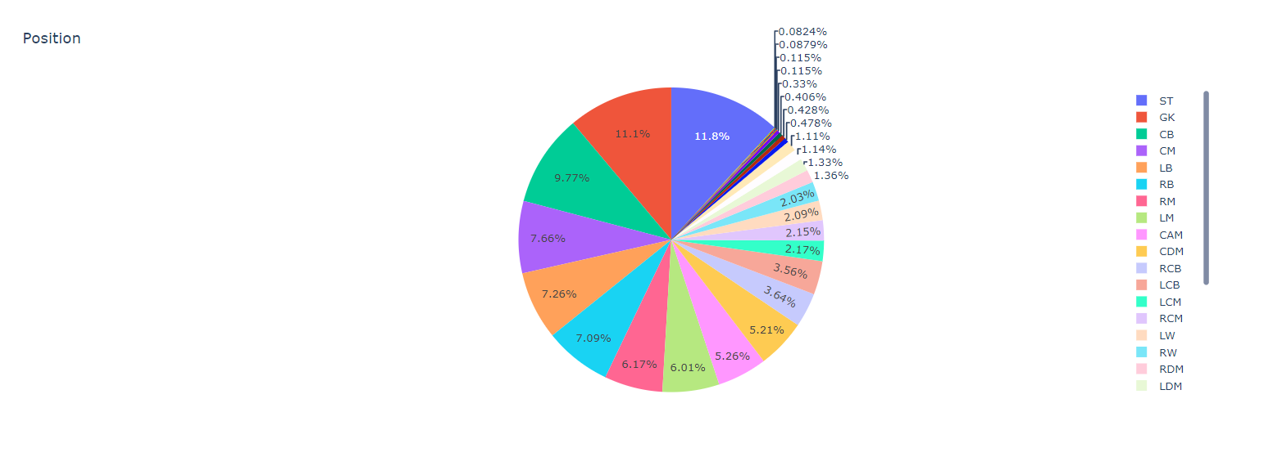
Player Count By Position

Slide 44
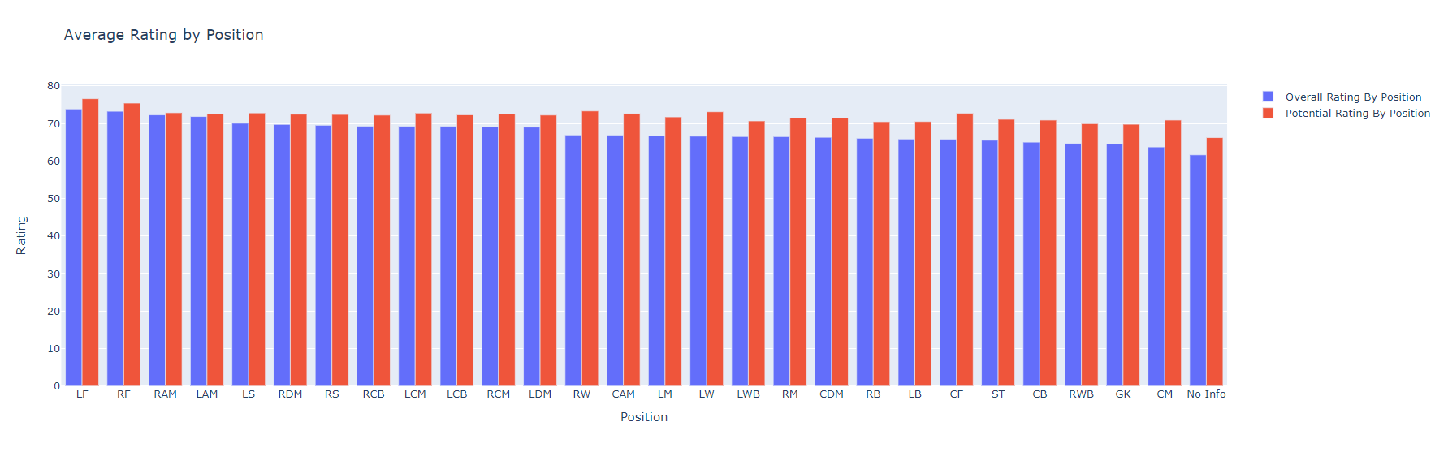
Average rating by position

Slide 45
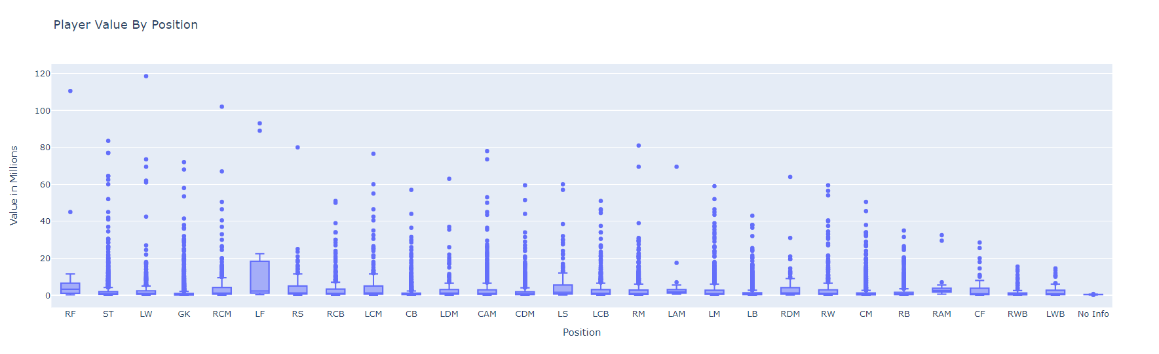
Player value by position

Slide 46
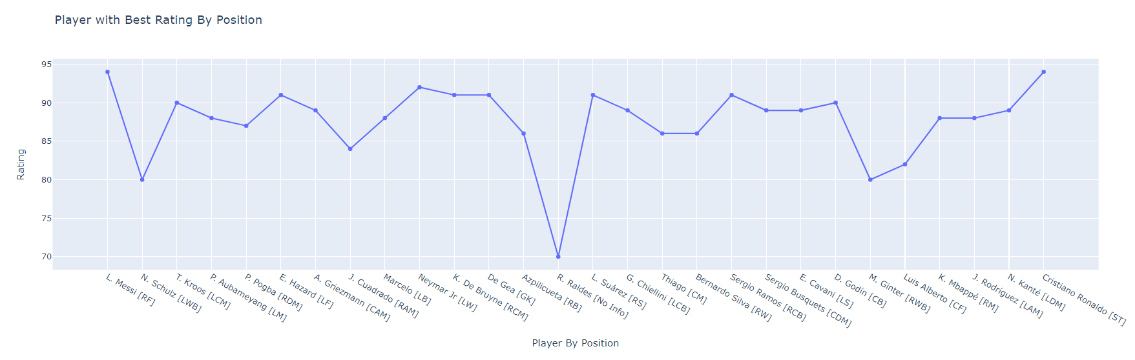
PLAYER WITH BEST RATING BY POSITION

Slide 47
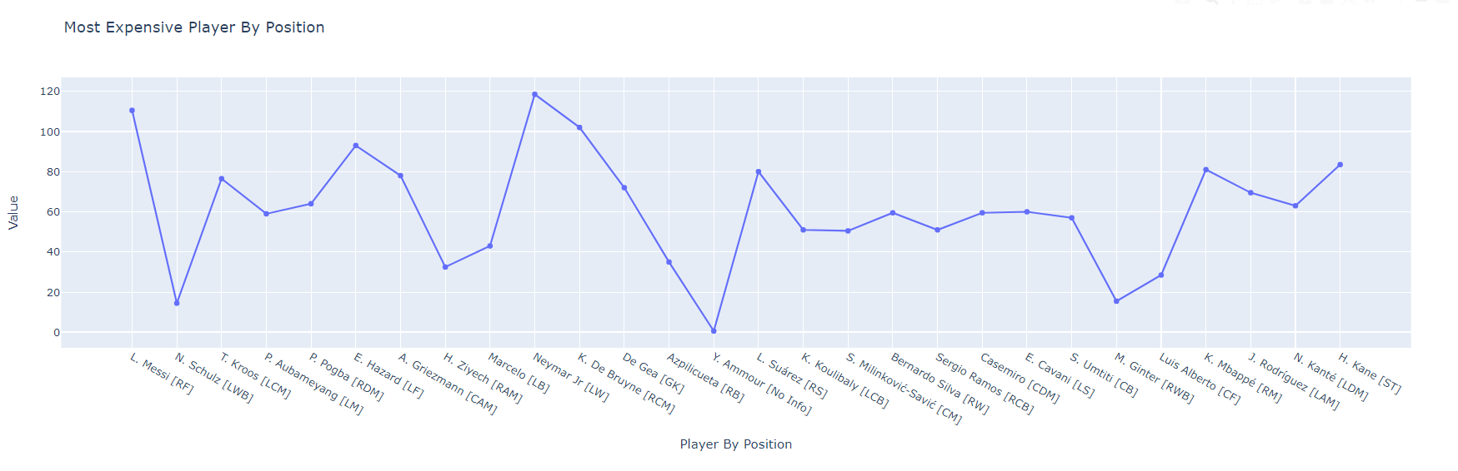
MOST EXPENSIVE PLAYER BY POSITION

Slide 48
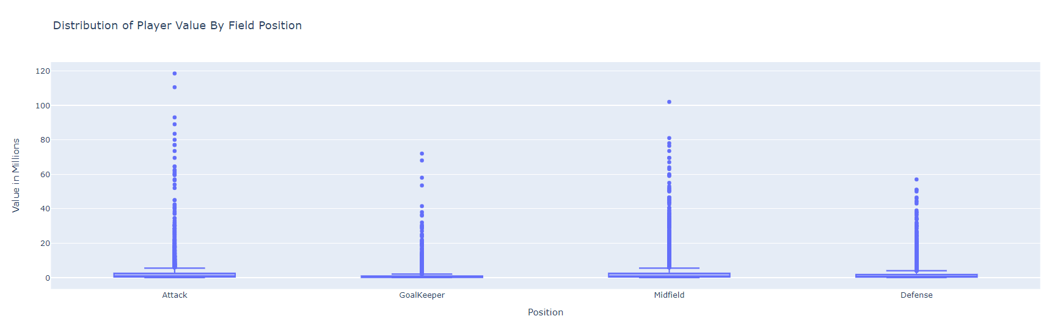
Distribution of player value by field position

Slide 49
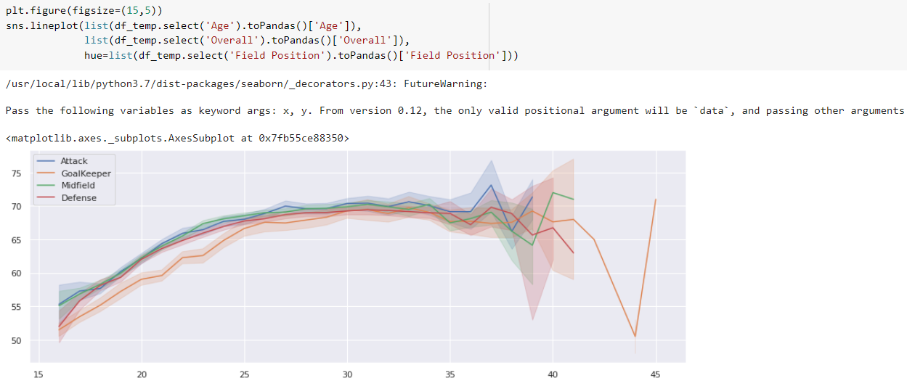
NO. OF PLAYERS VS AGE

Slide 50
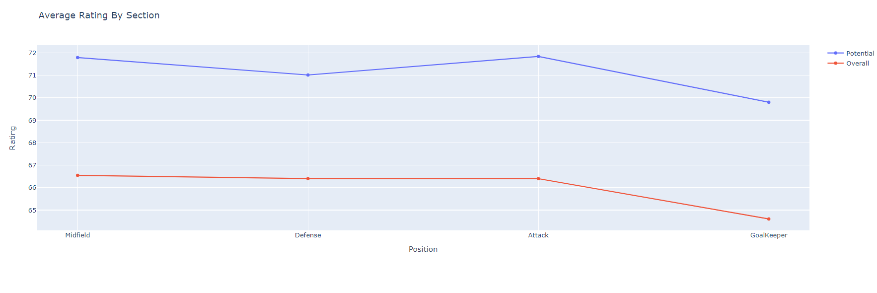
Average rating by section

Slide 51
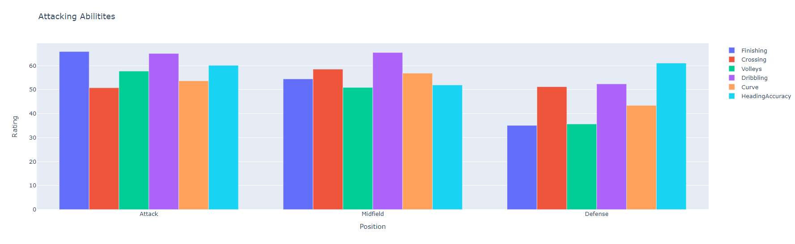
Attacking Abilities

Slide 52
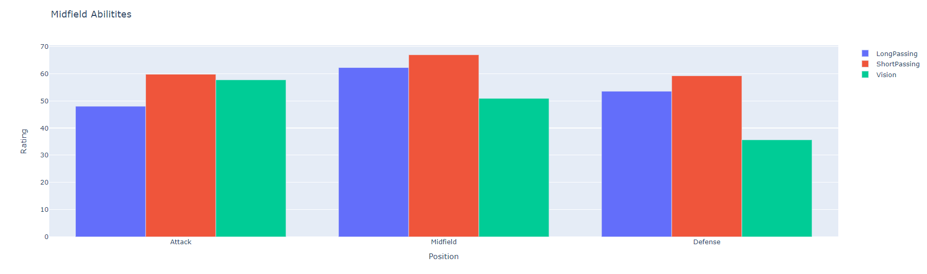
Midfield abilities

Slide 53
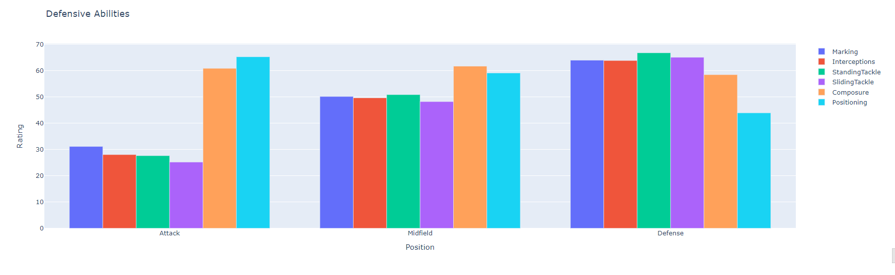
DEFENSIVE ABILITIES

Slide 54
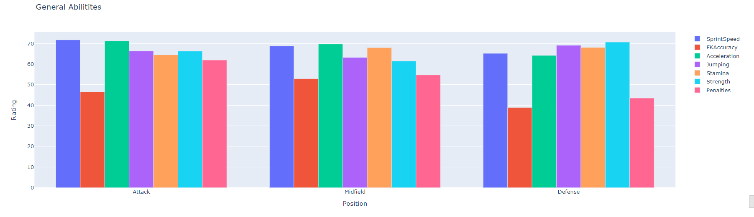
General Abilities

Slide 55
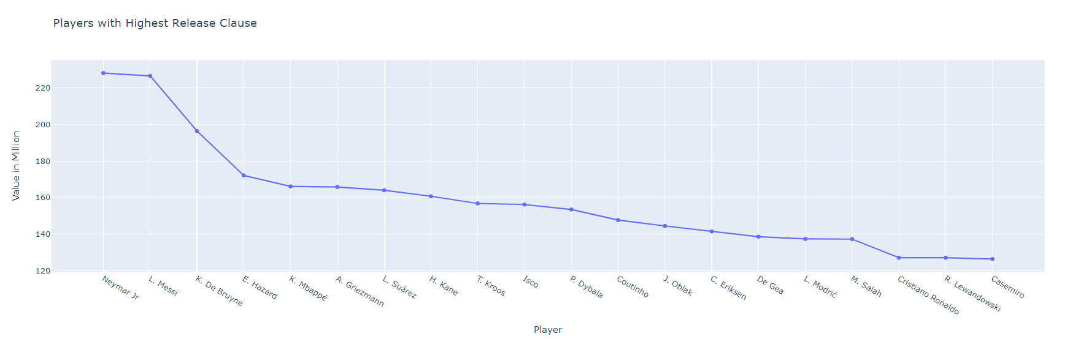
PLAYERS WITH HIGHEST RELEASE CLAUSE

Slide 56
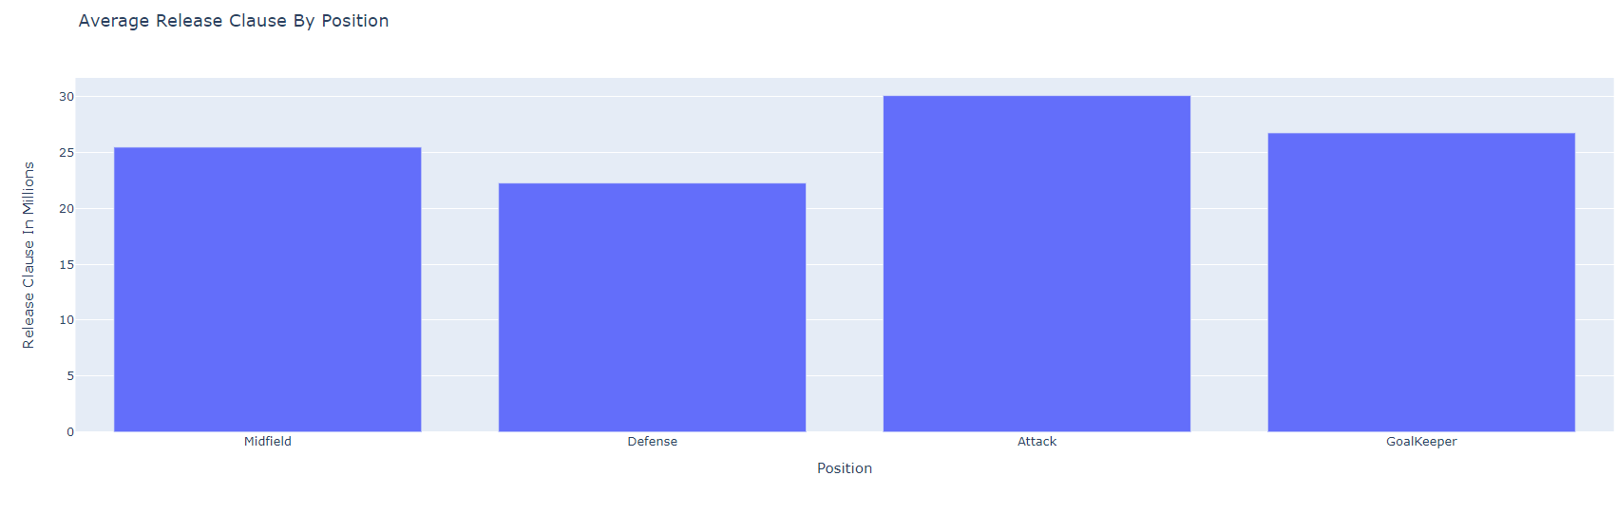
Average release clause by position

Slide 57
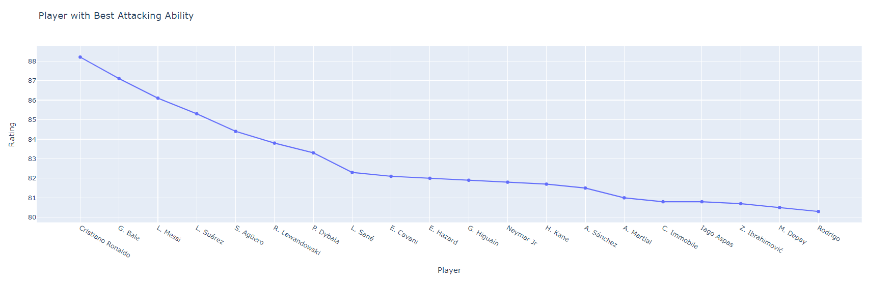
Player with best attacking ability

Slide 58
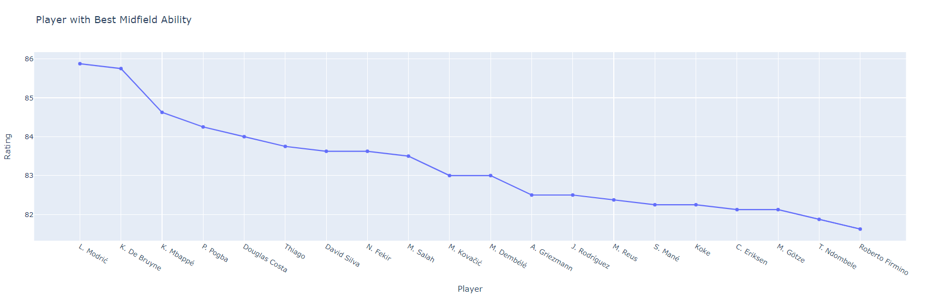
Player with best midfield ability

Slide 59
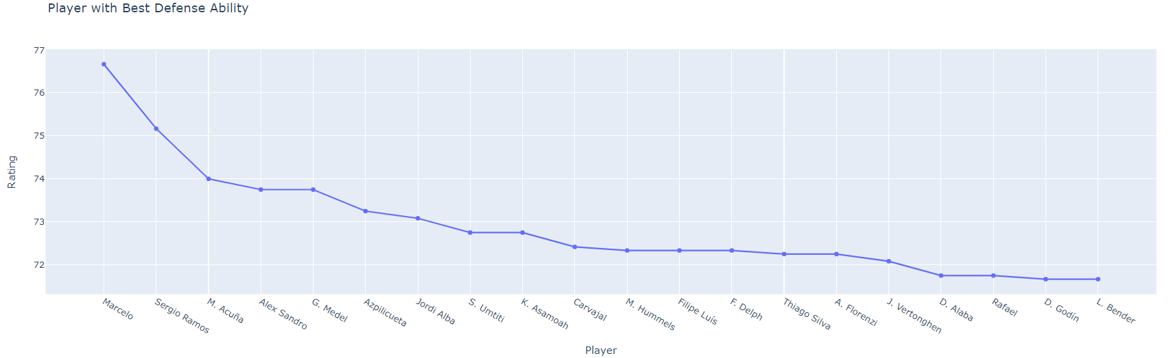
Player with best defensive ability

Slide 60
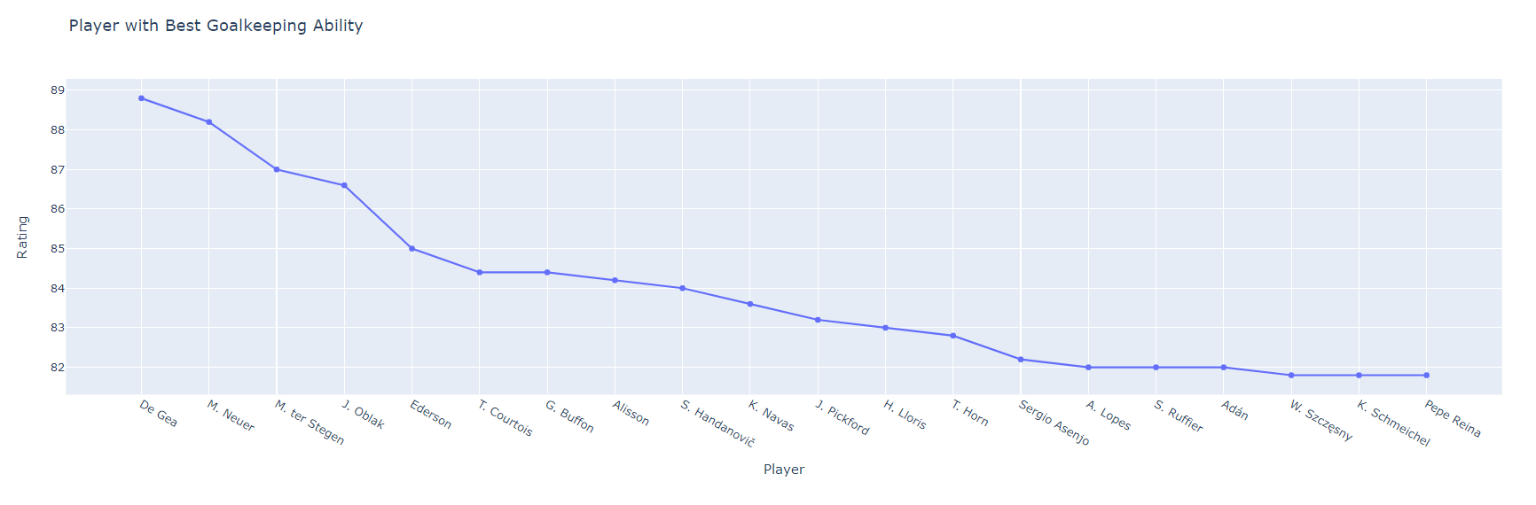
Player with best goal keeping ability

Slide 61
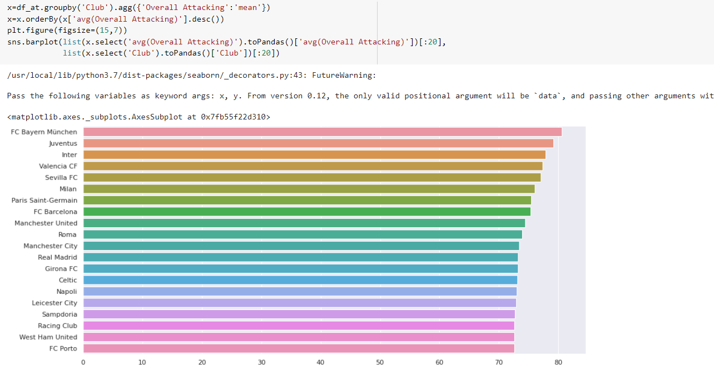
CLUB WITH BEST ATTACK

Slide 62
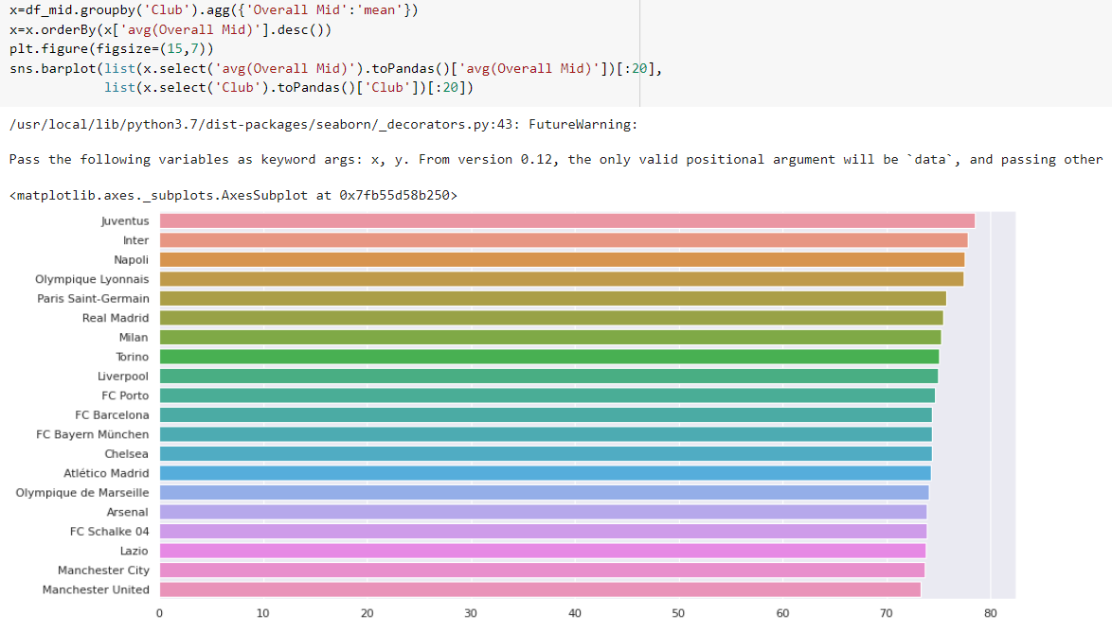
CLUB WITH BEST MIDFIELD

Slide 63
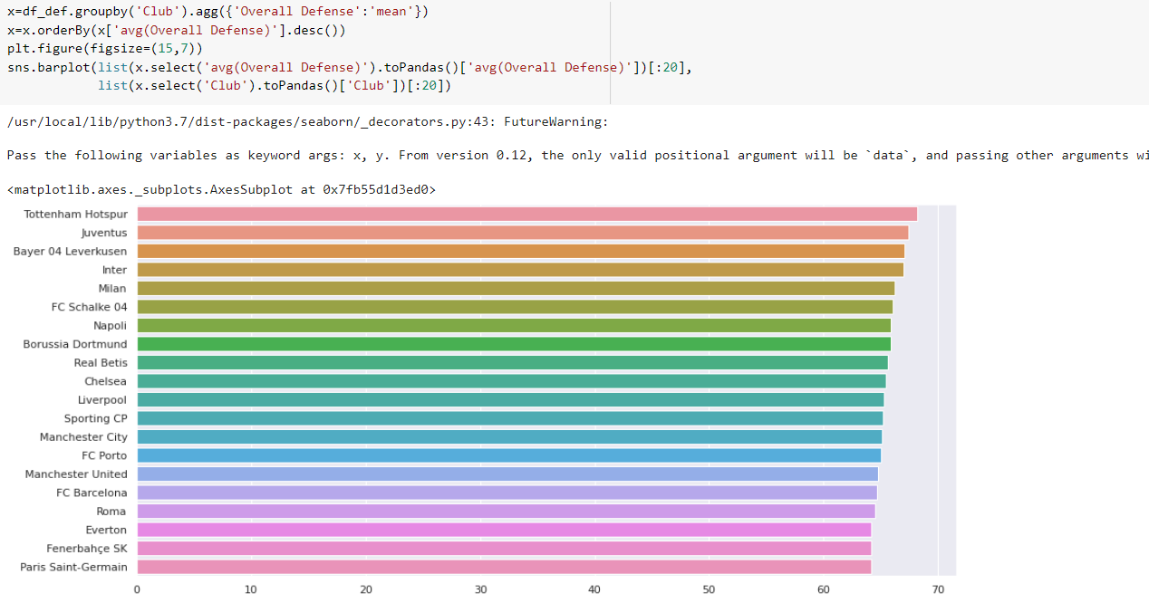
CLUB WITH BEST DEFENSE

Slide 64

BEST PLAYERS AT EACH ASPECT OF THE GAME

Slide 65

HOW AGE AFFECT PLAYER ABILITY

Slide 66

PCA SCORE VS OVERALL VARIABLE FOR FORWARD PLAYERS

Slide 67

PREMIER LEAGUE ANALYSIS

Slide 68
DATASET
The Premier League, often referred to as the English Premier League or the EPL is the top level of the English football league system .
It is contested by 20 clubs, it operates on a system of promotion and relegation.
Seasons run from August to May with each team playing 38 matches (playing all 19 other teams both home and away)
The dataset taken consists of the details corresponding to every premier league match taken place from 1993 season to 2021 season.

Slide 69
DATASET ATTRIBUTES
Season
Date and time
Home team
Away Team
FTHG- Full Time Home Goal
FTAG- Full Time Away Goal
FTR – Full Time Result
HTHG – Half Time Home Goal
HTAG – Half Time Away Goal
Referee
HS – Home Shots
AS- Away Shots
HST – Home Shots on Target
AST- Away Shots on Target
15. HC- Home Corner
16. AC- Away Corner
17. HF- Home Foul
18. AF- Away Foul
19.HY- Home Yellow
20. AY- Away Yellow
21. HR- Home Red
22. AR- Away Red

Slide 70

HEAD OF THE DATASET

Slide 71


DATA CLEANING
The attributes such as FTHG,FTAG,HTR,HS,AS etc are not available from 1993 to 1999 season so the records from those seasons are dropped .

Slide 72

DATASET AFTER CLEANING :

Slide 73

DATA PRE-PROCESSING
The dataset pre-processing includes providing additional information such as the month and day for each match record which will facilitate further analysis on the data

Slide 74

DESCRIBE

Slide 75


SEASON WISE ANALYSIS:

Slide 76

ANALYSIS ON TOTAL GOALS SCORED SEASON WISE

Slide 77

SEASON-WISE ANALYSIS OF HOME AND WAY GOALS SCORED

Slide 78


MONTH WISE ANALYSIS FOR EACH SEASON

Slide 79

HEATMAP OF GOAL DISTRIBUTION BASED ON MONTH

Slide 80


MATCH WISE ANALYSIS FOR EACH MONTH

Slide 81

HEAT MAP OF GOALS PER MATCH BASED ON MONTH

Slide 82


HOME SHOTS VS AWAY SHOTS

Slide 83

OVERALL GOALS SCORED - CLUB WISE

Slide 84


SHOT CONVERSION RATE CALCULATION

Slide 85

SHOT CONVERSION RATE GRAPH

Slide 86

HOME WIN % CLUB WISE
Home win percentage is calculated for each club by grouping the FTR(Full time Result) by ‘HomeTeam’

Slide 87

HOME GROUND WIN %

Slide 88

RED CARDS ISSUED BY REFEREES

Slide 89


Slide 90
CREATING FEATURE TABLES TO TRAIN THE ML MODEL
The newly created feature table consists of attributes like
HGS-Home Goal Scored
AGS-Away Goal Scored
HAS-Home Attacking Strength
AAS-Away Attacking Strength
HGC-Home Goal Conceded
AGC-Away Goal Conceded
HDS-Home Defence Strength
ADS-Away Defensive Strength

Slide 91


Slide 92

GENERATED TRAINING SET #1

Slide 93

MERGING THE DATAFRAMES- TRAINING SET #2

Slide 94


TRAINING THE MODEL
The training set #1 and training set #2 are trained with 3 different algorithms:
1)Naïve Bayes
2)SVM
3)Logistic Regression

Slide 95

ACCURACY
TRAINING SET #1 TRAINING SET #2
TRAINING SET | NAÏVE BAYES | SVM | LOGISTIC REGRESSION
#1 | 46 | 51 | 52
#2 | 54 | 57 | 57

Slide 96
THANK YOU !!! ☺

